Slide 1
Thiru. I.K Lenin Tamilkovan
Executive Director (FAC)
Tamilnadu Science and Technology Centre, Chennai.

Slide 2
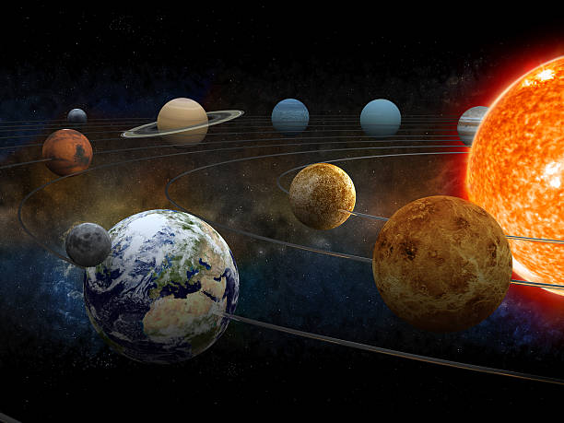
SOLAR SYSTEM
The Solar System is a system formed by the bond of gravity between the sun and the objects around it.

Slide 3
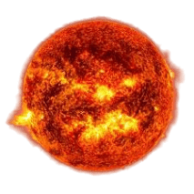
THE SUN
The sun is only source of energy for the Earth and we continue to get energy from the sun through nuclear fission.

Slide 4
PLANETS
Planets in the solar system can be divided into two types
1. Inner Planets
2. Outer Planets
Planets are made of dense, rocks are called Inner Planets. The Inner planets are Mercury, Venus, Earth and Mars.
Planets made up of cold gas are called Outer planets. The Outer planets are Jupiter, Saturn, Uranus and Neptune.

Slide 5
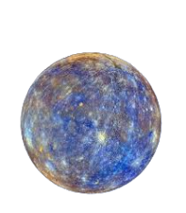
MERCURY
Mercury is the smallest planet in the vicinity of the sun. It has no atmosphere. Although it resembles the Earth’s Moon in size, its temperature ranges from -180 to 430 degree Celsius. There is no conductive environment for humans to live. It has no Moons

Slide 6
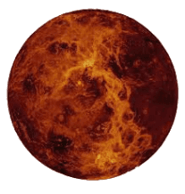
VENUS
The closest planet to Earth is the Venus. The size of the planet corresponds to that of Earth. The planet has the hottest temperature around 500 degrees Celsius and making it impossible to survive there, It is called the earth’s sister planet because it has a similar gravitational attraction to the Earth. It has no moons

Slide 7
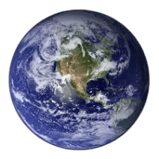
THE EARTH
Earth alone has the appropriate conducive environment for the living beings to live. This planet is called the blue planet because most of the Earth is filled with water. It has a natural satellite called Moon.

Slide 8
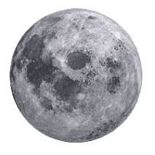
MOON
Earth's only natural satellite is simply called "the Moon" because people didn't know other moons existed until Galileo Galilei discovered four moons orbiting Jupiter in 1610. In Latin, the Moon was called Luna, which is the main adjective for all things Moon-related: lunar.

Slide 9
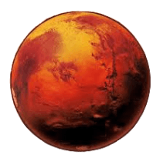
MARS
Mars is the reddish planet, and is reddish due to iron oxide present on its surface. It has two moons named as Phobos and Deimos. The highest mountain and volcano in the Solar System is on the planet Mars. It is called Olympus Mons and is 16 miles (24 kilometers) high which makes it about three times higher than Mt. Everest.

Slide 10
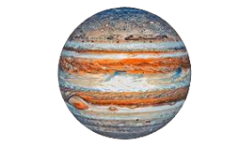
JUPITER
Jupiter is about 1330 times larger than Earth. It has 79 Moons and Ganymede, Callisto, Europa and Io are the largest moons. Jupiter’s gravity is 2.5 times that of the Earth so that, it attracts most of the asteroids keeping the Earth safe.

Slide 11
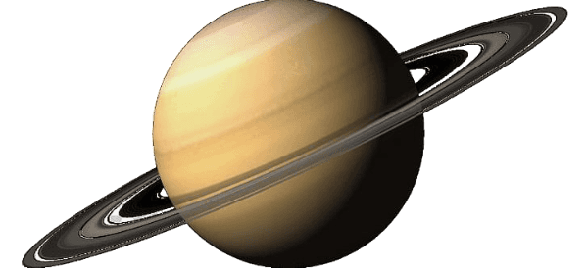
SATURN
The only planet with beautiful large rings. The Density of the planet is less than water. Despite having one-eighth of Earth’s density, it has 95 times more mass than Earth. It has approximately 62 moons and the largest moon is Titan.

Slide 12
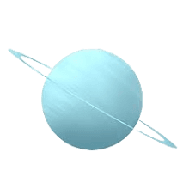
URANUS
Uranus is a gaseous planet. Due to its rotational axis tilted about 97 degree one part of the planets is night and the other part is day. This continues for 42 years. It has 27 moons. The largest Moons of the planet Uranus are Miranda, Ariel, Umbriel and Titania. It has 13 known rings.

Slide 13
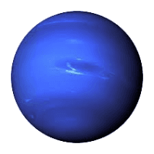
NEPTUNE
Neptune is gaseous planet. It is surrounded by a ring of gas. It has about 14 satellites. The main satellite is Triton.

Slide 14
GALAXY
A Galaxy is a huge collection of gas, dust, and billions of stars and their solar systems. A Galaxy is held together by gravity.
The types of Galaxies are:
Spiral galaxy
Elliptical galaxy
Lenticular galaxy
Irregular galaxy
Active galaxy
Seyfert galaxy
Quasars
Blazars

Slide 15
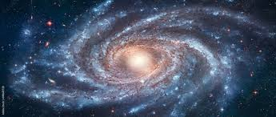
MILKY WAY GALAXY
Our Galaxy, the Milky Way, also has a super massive black hole in the middle. It is a Spiral galaxy, if we view the galaxy from the top or bottom, it would look like a spinning pinwheel. The Sun is located on one the spiral arms, about 25,000 light-years away from the Meter of the galaxy.

Slide 16
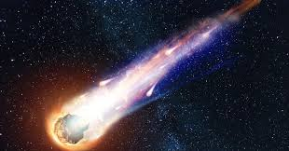
COMETS
A Comet is an icy, small Solar system body that warms and begins to release gases when passing close to the
Sun, a process called outgassing. Comets usually have highly eccentric elliptical orbits, and they have a wide range of orbital periods, ranging from several years to potentially several millions of years.

Slide 17
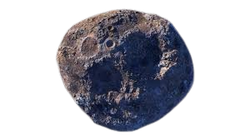
ASTEROIDS
An Asteroid is a minor planet- an object that is neither a true planet nor an identified comet- that orbits within the inner solar system. The rocky, metallic , or icy bodies with no atmosphere. The size and shape of asteroids vary significantly, ranging from small rubble piles under a kilometer across and large than meteoroids, to Ceres, a dwarf planet.

Slide 18
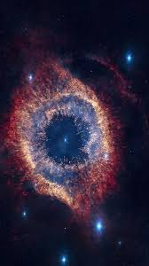
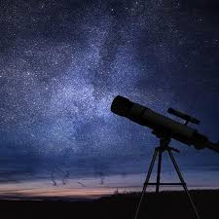
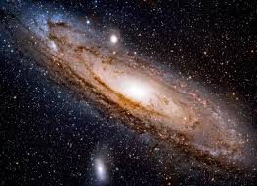
BRANCHES OF ASTRONOMY

Slide 19
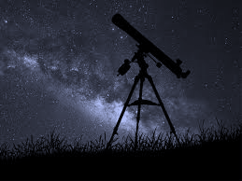
COSMOLOGY
ASTROPHYSICS
ASTROBIOLOGY
COSMOLOGY
ASTROCHEMISTRY
ASTROGEOLOGY
HELIOPHYSICS
BRANCHES
OF
ASTRONOMY
HELIOSEISMOLOGY
EXOPLANETOLOGY
SPECTROSCOPY
PLANETOLOGY
PHOTOMETRY
EXOBIOLOGY
AREOLOGY

Slide 20
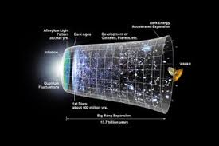
ASTROPHYSICS
Astrophysics applies the principles of physics to astronomy. It relates physical processes and properties to stars, celestial bodies, and its surrounding space.
COSMOLOGY
Cosmology is different from astrophysics because it studies the evolution and expansion of the universe. How the universe was created, evolved, and its ultimate fate.

Slide 21
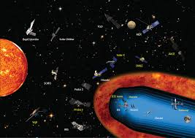
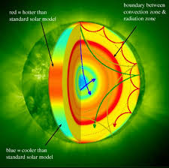
HELIOPHYSICS
Studies How the Sun’s constant and dynamic radiation affects its surroundings in space.
HELIOSEISMOLOGY
Studies How the Interior structure and dynamics of stars are composed by observing waves from their surface.

Slide 22
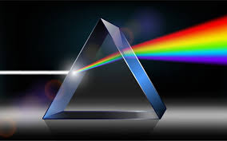
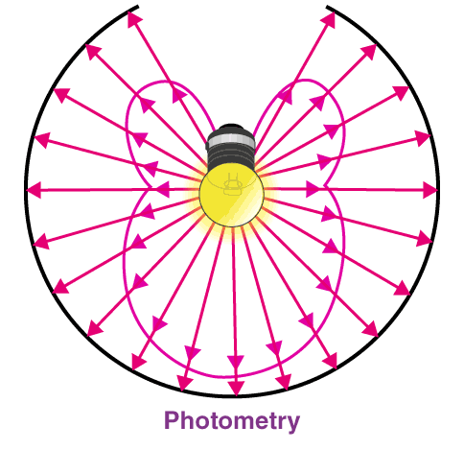
SPECTROSCOPY
Studies the Reflection Adsorption and transfer of light between matter.
PHOTOMETRTY
Studies How Luminous Astronomical objects are in Space Based in Electromagnetic radiation.

Slide 23
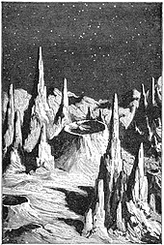
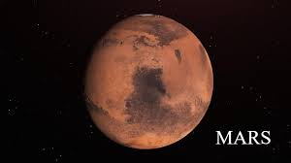
SELENOGRAPHY
Studies physical features on the Moon formed such as Lunar Maria, Craters and Mountain Ranges.
AREOLOGY
Study of geology of Mars.

Slide 24
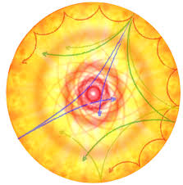
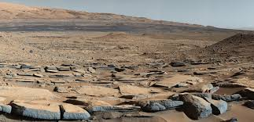
ASTEROSEISMOLOGY
Studies the Internal Structure of stars by Observing their oscillations.
ASTROGEOLOGY
Geology relates to celestial bodies like Moons, Asteroids, Meteorites and Comets.

Slide 25
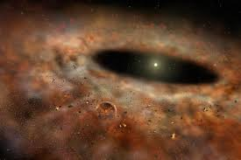
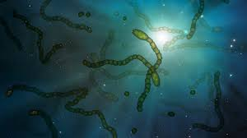
EXOPLANETOLOGY
How much and where planets exist outside our Solar system.
ASTROBIOLOGY
Studies evolution, origin and
fate of all life in the Universe.

Slide 26
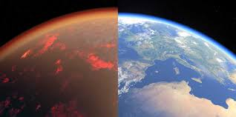
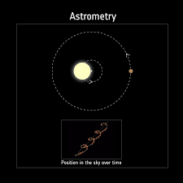
PLANETOLOGY
Studies how planets form in the Solar systems including their composition and dynamics in History.
ASTROMETRY
Studies Position and Movement of Celestial bodies in Space.

Slide 27
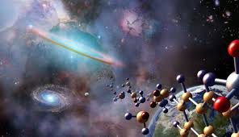
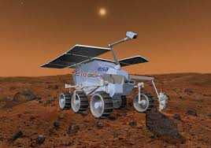
ASTROCHEMISTRY
Study of substances in Celestial bodies, stars and Interstellar space.
EXOBIOLOGY
Studies Likeliness and potential location of life in space

Slide 28
TELESCOPES
Telescopes use lenses, mirrors, or a combination of both to collect and focus light. The primary components include:
Objective: The main lens or mirror that gathers light from the target object.
Eyepiece: The lens that magnifies the image formed by the objective.
Tube: The housing that holds the optical components and maintains alignment.
Mount: The structure that supports the telescope and allows it to be pointed and tracked.
The specific design and materials used vary depending on the type and purpose of the telescope.

Slide 29
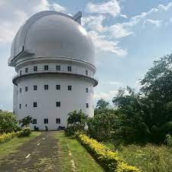
Uses of telescopes
Observing celestial objects like stars, planets and galaxies.
Monitoring and tracking artificial satellites in Earth’s orbit.
Contributions to various scientific research fields through detailed observations.
Space exploration by providing detailed observations of distant space objects.
Studying the properties and behavior of astronomical phenomena.
The Vainu Bappu Observatory is an astronomical observatory owned and operated by the Indian Institute of Astrophysics. It is located at Kavalur in the Javadu Hills, near Vaniyambadi in Tirupathur district in the Indian state of Tamil Nadu.

Slide 30
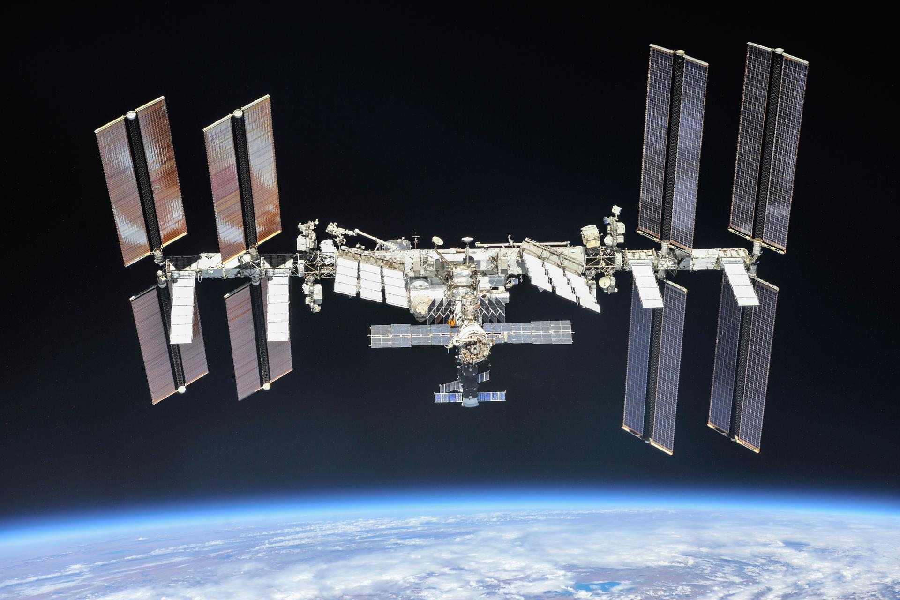
International Space Station !!
The station was designed between 1984 and 1993. Elements of the station were in construction throughout the US, Canada, Japan, and Europe beginning in the late 1980s.
The International Space Station Program brings together international flight crews, multiple launch vehicles, globally distributed launch and flight operations, training, engineering, and development facilities, communications networks, and the international scientific research community.

Slide 31
Astronomy institutions in India.
Indian Institute of Astrophysics (IIA), Bangalore.
Aryabhatta Research Institute of Observational Sciences (ARIES), Nainital.
Indian Institute of Science (IISc), Bangalore.
Indian Institute of Space Science and Technology (IIST), Thiruvananthapuram.
Inter-University Centre for Astronomy and Astrophysics (IUCAA), Pune.
National Centre for Radio Astronomy (NCRA), Pune.
Tata Institute of Fundamental Research (TIFR).
These institutions contributes significantly to both theoretical and observational aspects of astronomy and space science in India.

Slide 32
OPPORTUNITIES OF ASTROPHYSICS
1. Research Positions: Opportunities to work as a researcher in universities, research institutes, and observatories.
Teaching and Academia: Careers in academia as professors or lecturers in universities and colleges.
Space Agencies: Employment with space agencies like NASA, ESA, ISRO, etc., working on space missions and satellite projects.
Private Sector: Opportunities in private companies involved in space technology, satellite communications, and instrumentation.
Data Science: Roles in data analysis and interpretation using astronomical data sets, leveraging skills in computational astrophysics.
Instrumentation and Technology Development: Careers in developing new instruments and technologies for telescopes and space missions.
Science Communication: Opportunities in science journalism, outreach, and education to communicate discoveries and developments in astrophysics to the public.
Interdisciplinary Research: Collaborative opportunities with other scientific disciplines such as physics, computer science, mathematics, and engineering

Slide 33
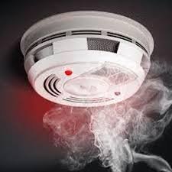
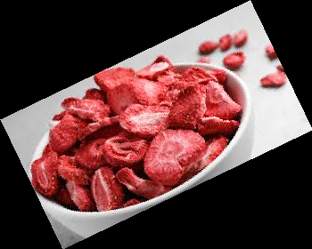
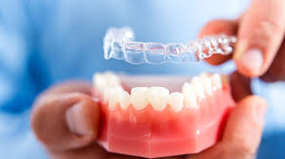

Spin off Space Exploration
Spin –off space technologies are commercial products and services which have been developed with the help of NASA, through research and development referring to well known commercial products that includes
freeze dried food
firefighting equipments
emergency ”space blankets”,
memory foam,
water filters
invisible braces
smoke detector
cordless tools
wireless headset
etc

Slide 34
THANK YOU

